Slide 1
VaxINFO
Process Book
Creators: Meenakshi Iyer, Jake Reid, Vin Tyagi

Slide 2
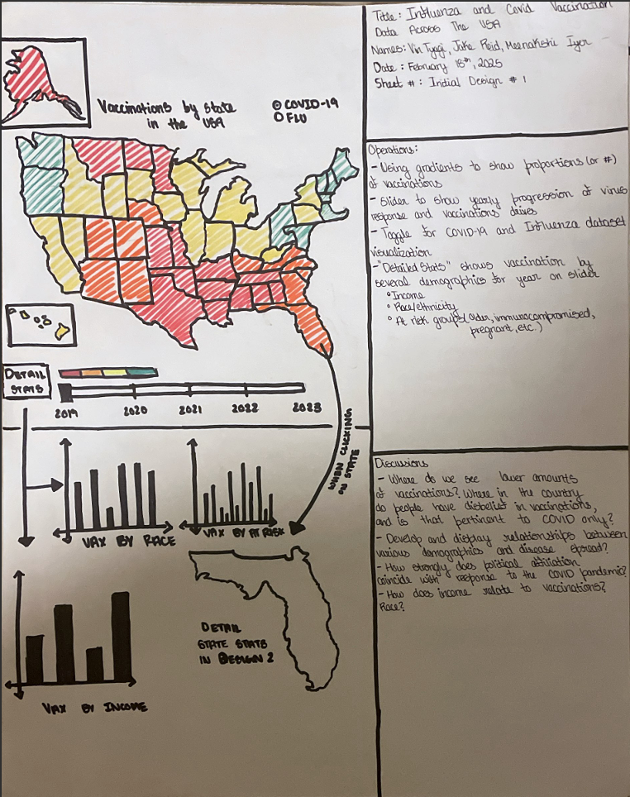
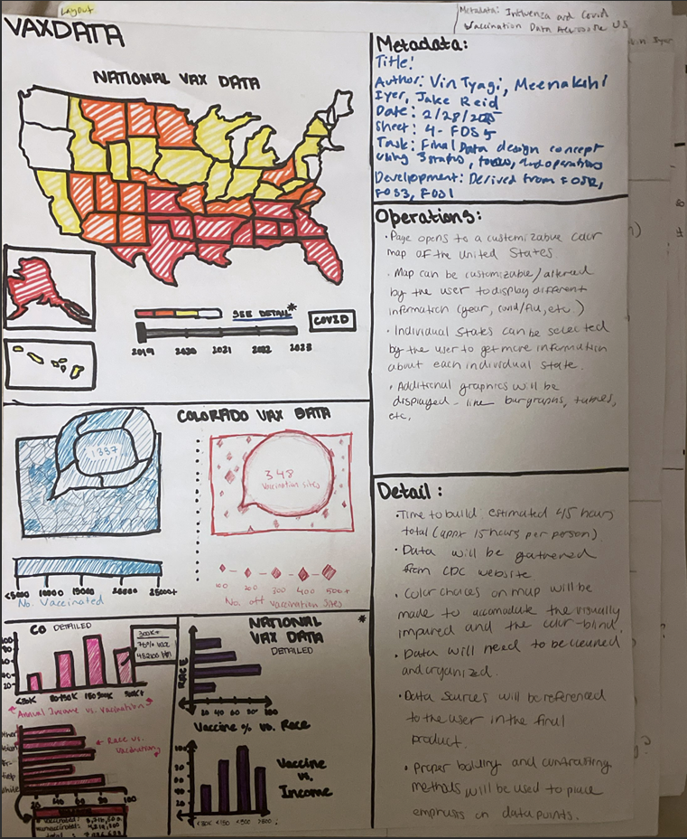
Proposal - Initial Design

Slide 3
APPROACH - INTUITION/MOTIVATION
Our goal was to be able to provide an interactive dashboard that presents recent COVID-19 and flu vaccination data in one spot, making it easier to compare progress and public reception to vaccination efforts to both of the viruses. The dashboard also provides significant insight into how different demographics respond to the two vaccinations.
This data is readily available on the CDC website and includes various visualizations - yet lacks the ability to easily compare vaccination progress among the 2 viruses. Our goal is for VaxINFO to provide comprehensive visualizations that allow users to easily compare COVID and flu vaccination data and provide more insight into trends occurring across the United States.

Slide 4
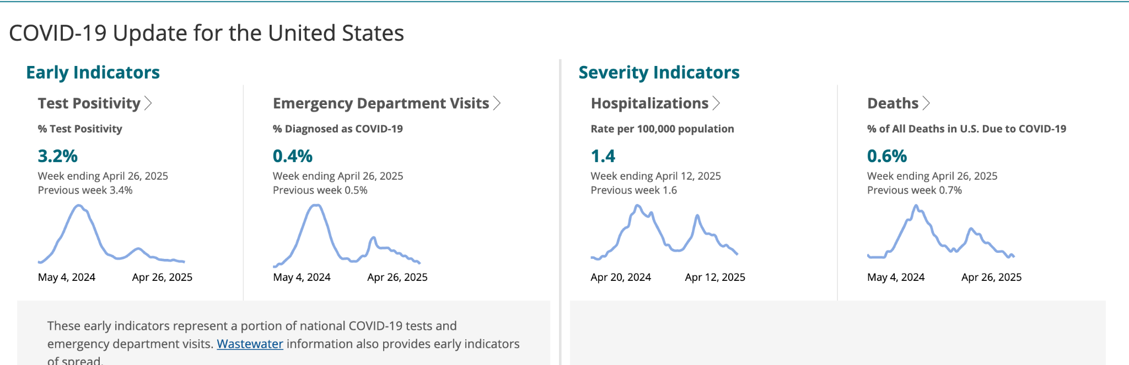
RELATED WORKS
We were initially inspired by the CDC’s website of Covid data, but it was limited to recent days, and we wanted to understand how the data looked across the span of the last few years.

Slide 5
QUESTIONS
Some of the questions that guided us:
How do the vaccination rates change across the country?
What might be an indicator of vaccination rates for covid vs flu? Why might one be higher than the other?
What effect do the different metrics have on vaccination rates for both Covid and Flu?
How do vaccination rates for Covid change throughout the pandemic?
For the most part, these stayed the same throughout the course of the project, but we also wanted to view all these through the lens of making a fair and friendly visualization, which prompted us to design our visualization in a way that prioritized cleanliness and accessibility over stuffing information that would technically answer these questions better.

Slide 6
PROCESS - INITIAL TASKS (DATA)
Our goal was to get estimate data from reputable sources, and we used the CDC datasets for Respiratory Virus survey data.
We have to keep in mind that the survey are samples, and may not always accurately reflect actual population parameters. The dataset contains roughly 40,000 tuples, with percentage estimates of how many people of certain demographics, regions, and indicators existed in the sample size.
The flu counterpart contains roughly 60,000 tuples as well, likely because the flu vaccination is not nearly as controversial, and would produce more numerous and more accurate results.

Slide 7
PROCESS - INITIAL DATA ANALYSIS
The NIS are a group of phone surveys used to monitor vaccination coverage among children, teens, and adults.
Estimates of vaccination coverage are determined for child and teen vaccinations recommended by the Advisory Committee on Immunization Practices (ACIP).
The NIS provides current, population-based, state and local area estimates of vaccination coverage using a standard survey methodology.
Since the original data included so many indicators for COVID reception, we filtered for survey results where the respondent had already received at least one dose of the COVID vaccine. Additionally, we also filtered for COVID and Flu metrics to show both in our toolset, intersecting with demographics we wanted to show.

Slide 8
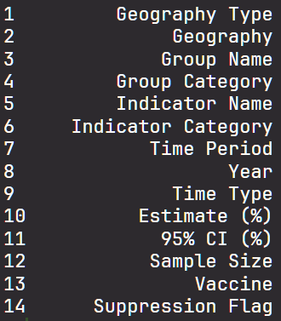
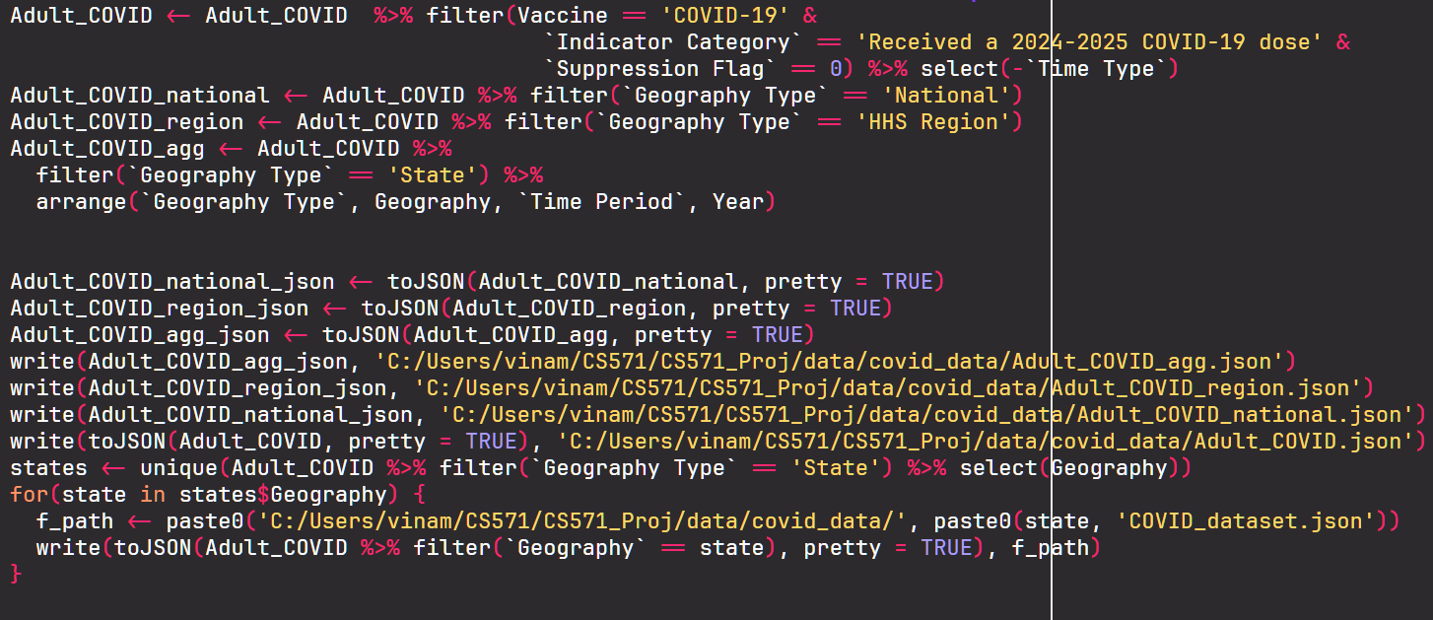
PROCESS - INITIAL DATA ANALYSIS

Slide 9
PROCESS - INITIAL DATA ANALYSIS
Additional data we collected from the CDC website included data on Vaccination centers. This data included lots of information and listed vaccination centers in single rows.
To do this, we used R to sum the data by city name (after some initial cleaning) then summed the data by city to create a single entry for each city - which inevitably lead to a count of the # of vaccination sites per city.
After that, we used a library in R to map the city name to longitude and latitude that could then be used for the map.

Slide 10
APPROACH - DESIGN
When thinking of mockups/wireframes and reaching consensus about the looks of the application, we were set on splitting the workload (of the visualization and of the developers), into two hemispheres: nationwide data, and statewide data.
The reasoning behind this was to provide users with a more generalized view of the COVID versus flu response, versus a more localized and small-scale experience in order to see where, within a territory or state, trends of COVID fared better or worse in comparison to the influenza virus.

Slide 11
APPROACH - DESIGN (CONT)
One design approach we made sure to take was the inclusion of a binary color split - such that the whole website will change color in order to reflect flu statistics versus COVID statistics. This allows users with visual impairments or deficiencies to have monochromatic scales when looking at data encoded over maps. This also will visually distinguish to the viewer which data they are currently viewing - minimizing the user’s ability to misinterpret data.
In addition, a design approach we prioritized was interactivity. We can’t display all of our data on one page, we need to give the user choice on what specific datasets / metrics are most important to them, and accessing that data via interaction is key. By providing interactive elements like clicking on specific states or selecting certain metric settings, the overall experience becomes enhanced for the individual user and allows them to explore data that they are personally interested in.

Slide 12
PROCESS - DEVELOPMENT
We are currently thinking of a design scheme with 2 main setups. Our process for how the viewer interacts with our website is to show a nationwide view of the data, with sliders that allow us to view the data timewise.
Hovering over or clicking on specific states on them app will allow us to view statewide data. Additionally, both national and state wide data viewports will provide opportunities for a detailed, demographic centered view of the data set, where users can filter through several demographics and indicators to find detailed information about vaccination efforts.

Slide 13
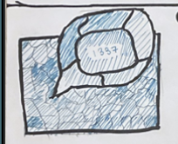
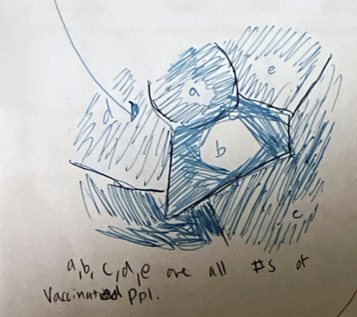
PROCESS - DEVELOPMENT
Since the milestone, we had one major change, which was to omit the county rates that would’ve been displayed like below. Given that we were not able to find the data for that (doing so would’ve required extensive parsing and calculations on the data, which was infeasible), we decided it would be a better use of our time to work on refining the other parts.

Slide 14
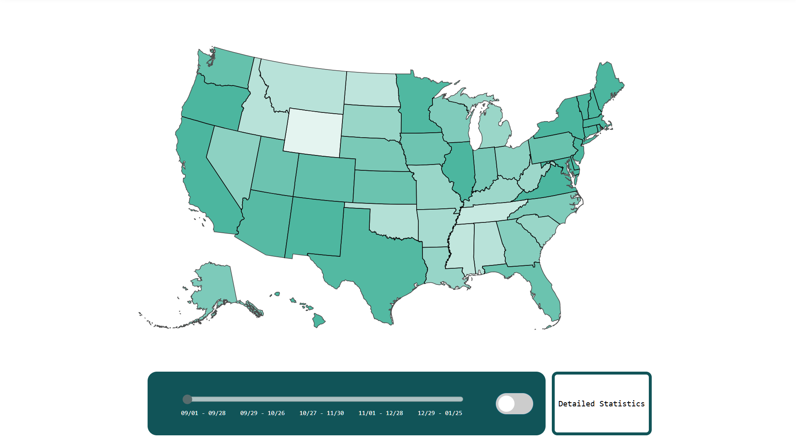
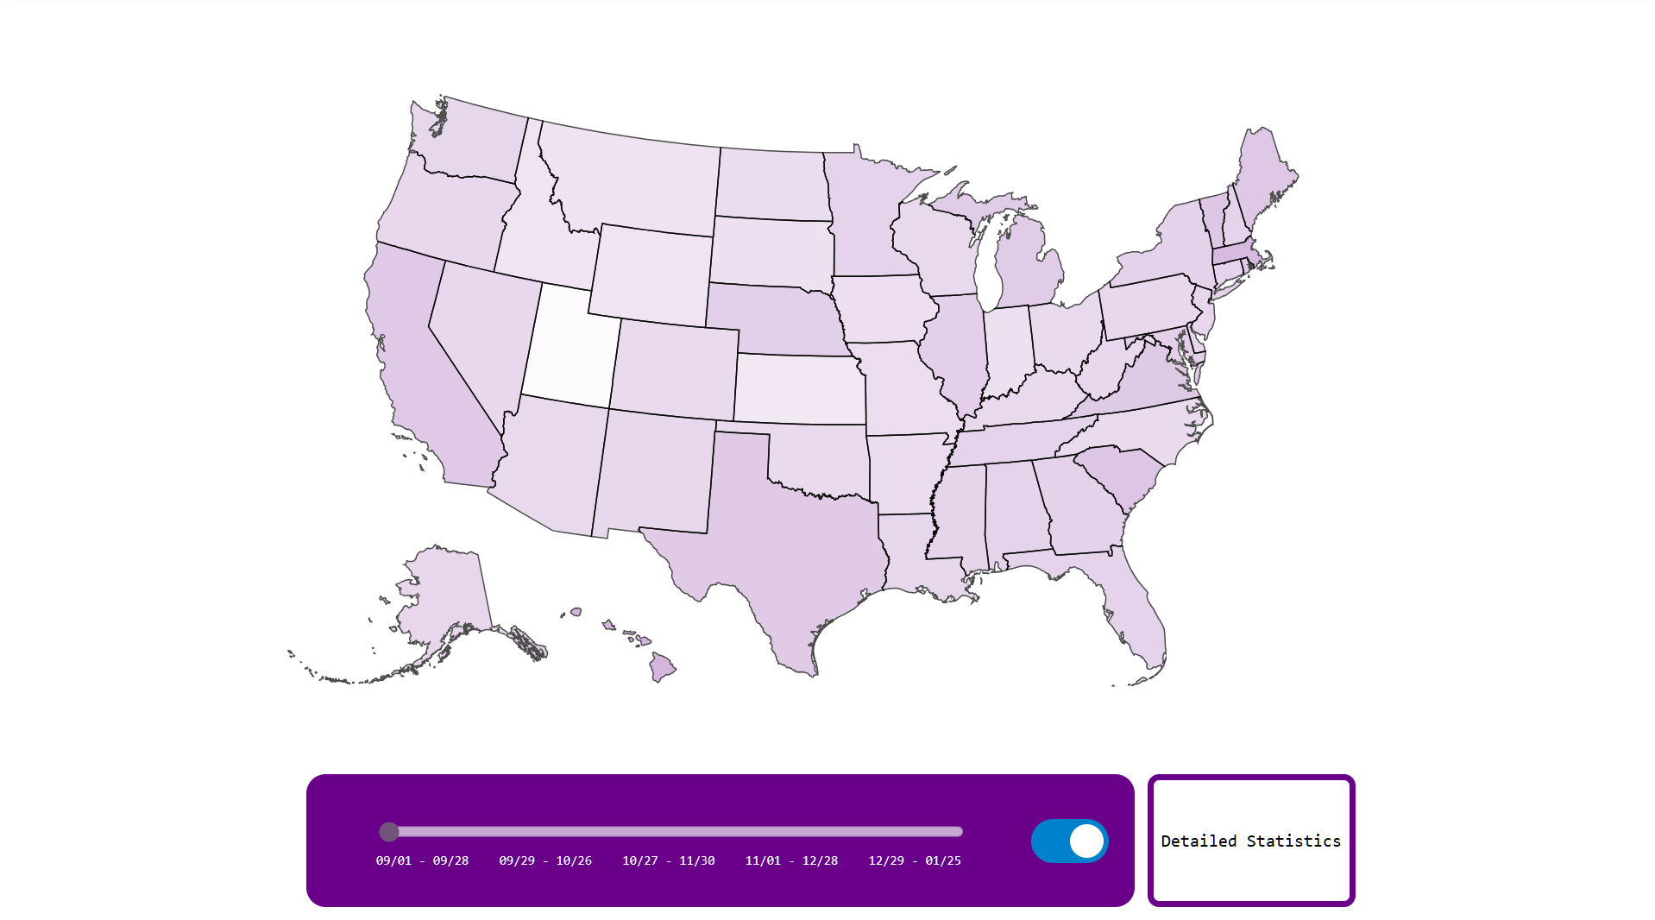
PROCESS - IMPLEMENTATION PHASE 1
Button for detailed statistics on demographics such as race, ethnicity, age, education/literacy,
Sexual orientation, residence in rural or urban areas
State
View when clicking on state (NEXT SLIDE)
Time slider
Flu/COVID Toggle

Slide 15
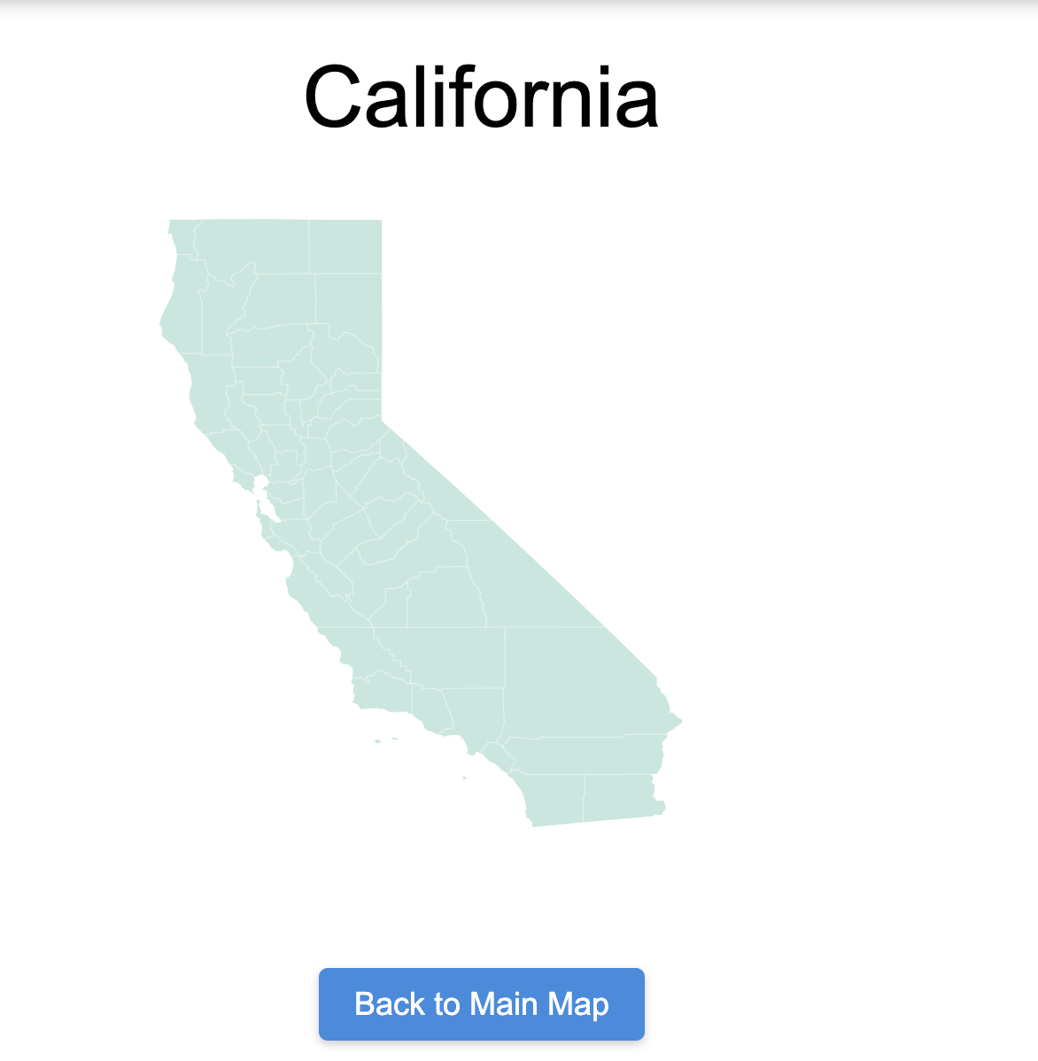
PROCESS - IMPLEMENTATION PHASE 2
STATE VIEW:
Reached when clicking on any state from the national view
County lines to show location
Button to go back to main view

Slide 16
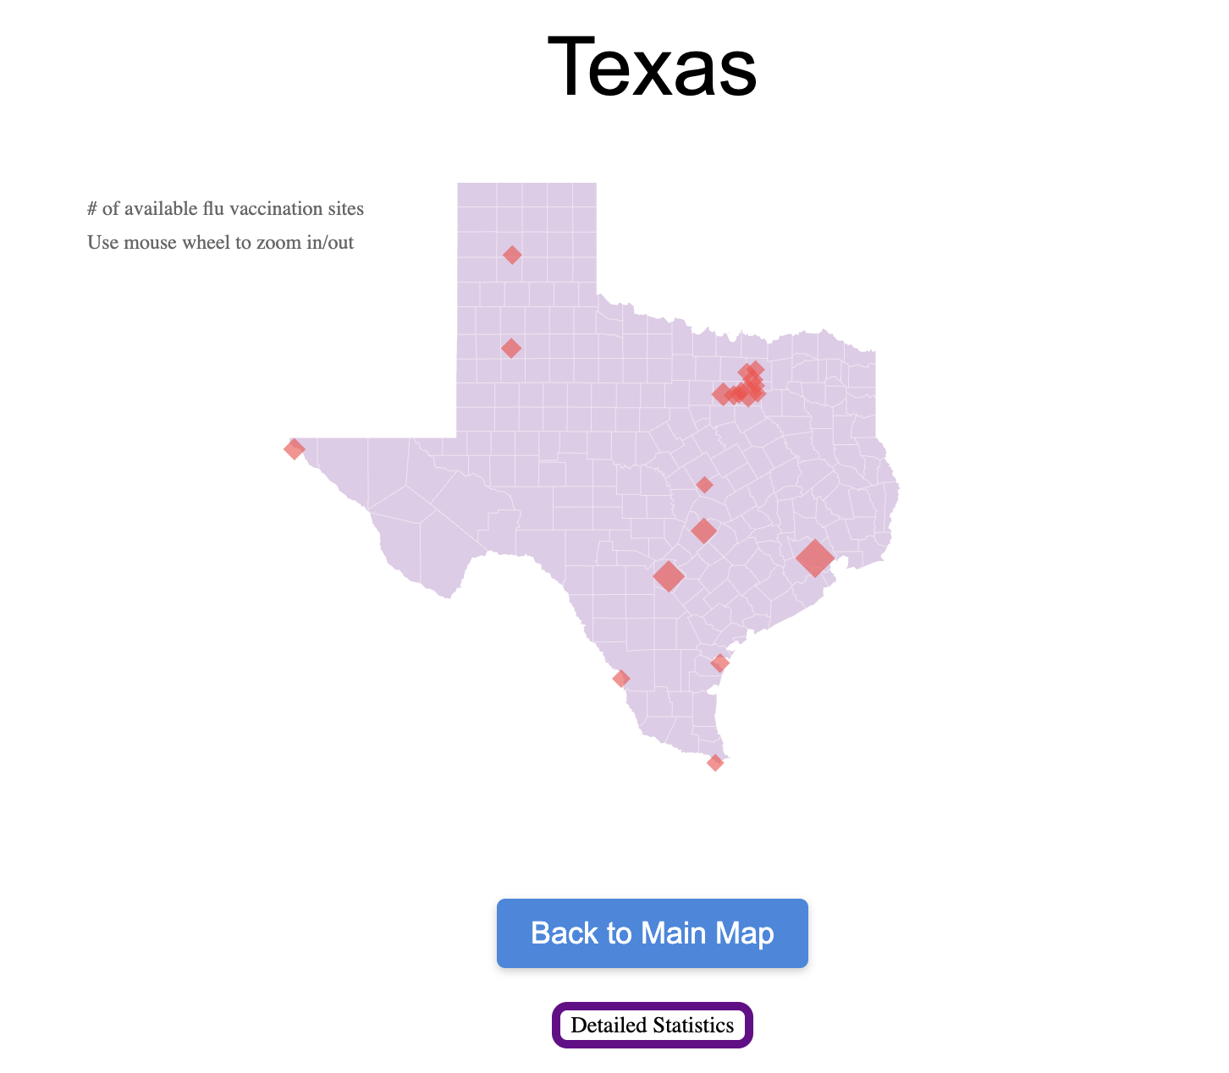
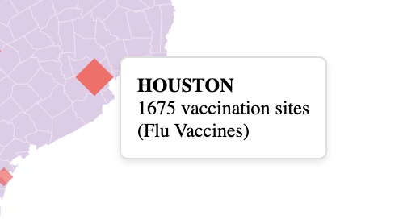
PROCESS - IMPLEMENTATION PHASE 3
STATE VIEW:
Red Diamonds represent the density of vaccination spots in a city. The larger the diamond, the more vaccination spots (toggle for flu/covid). Hovering displays the exact amount of sites. Here, we decided to not do the rates across the country, since we could not get good data for this.

Slide 17
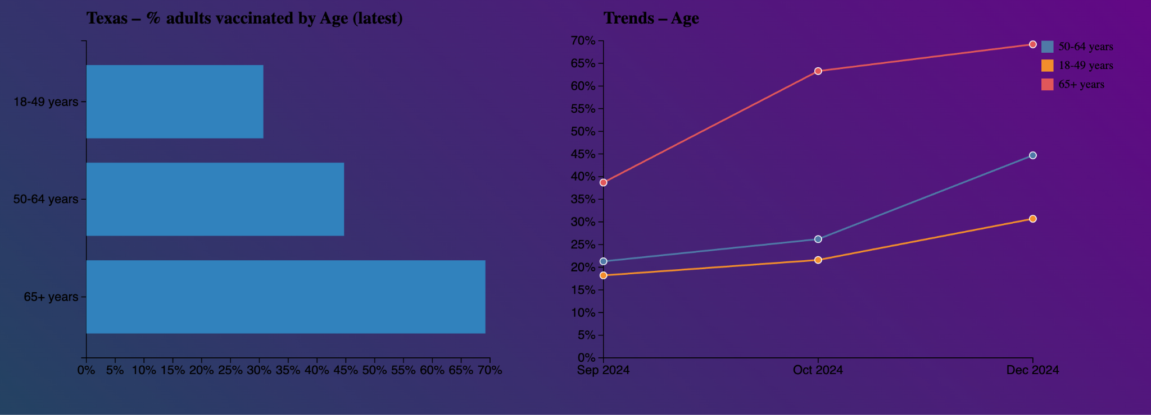
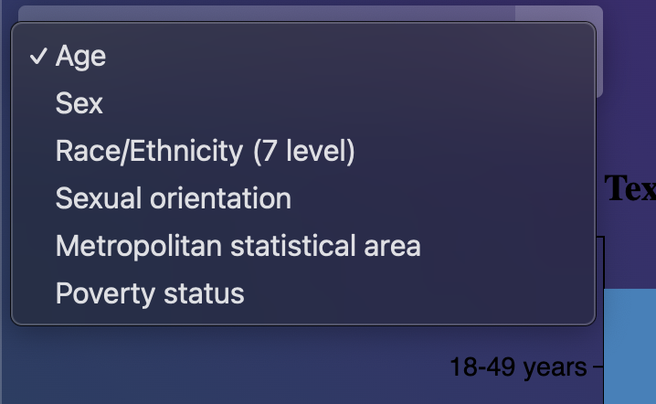
PROCESS - IMPLEMENTATION PHASE 4
STATE VIEW:
These graphs show the trend over time for different metrics, which can be edited using the toggle in the upper left corner. These are displayed on a state level.

Slide 18
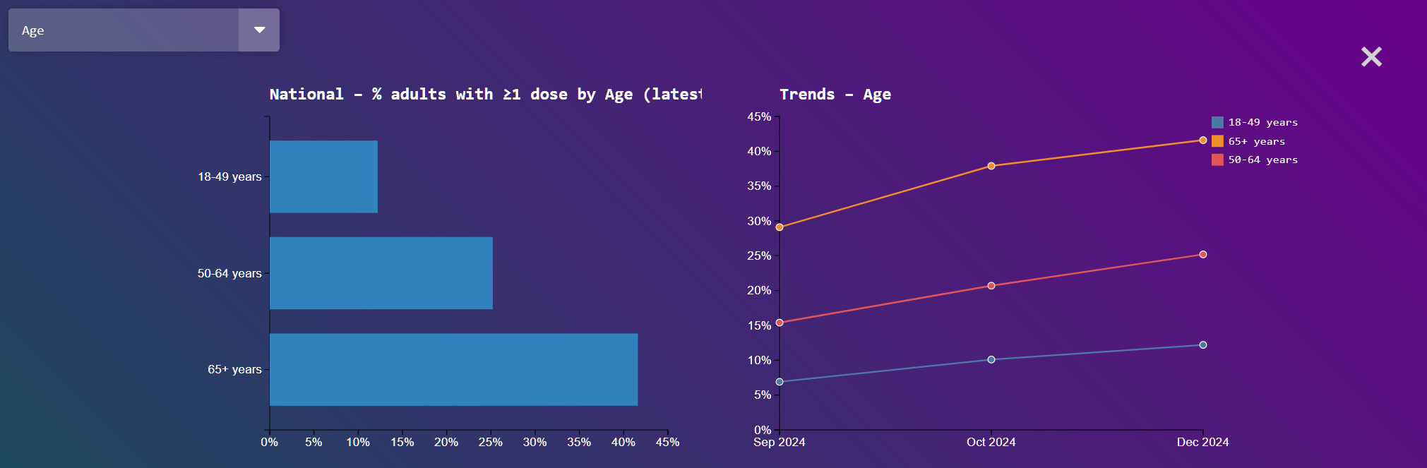
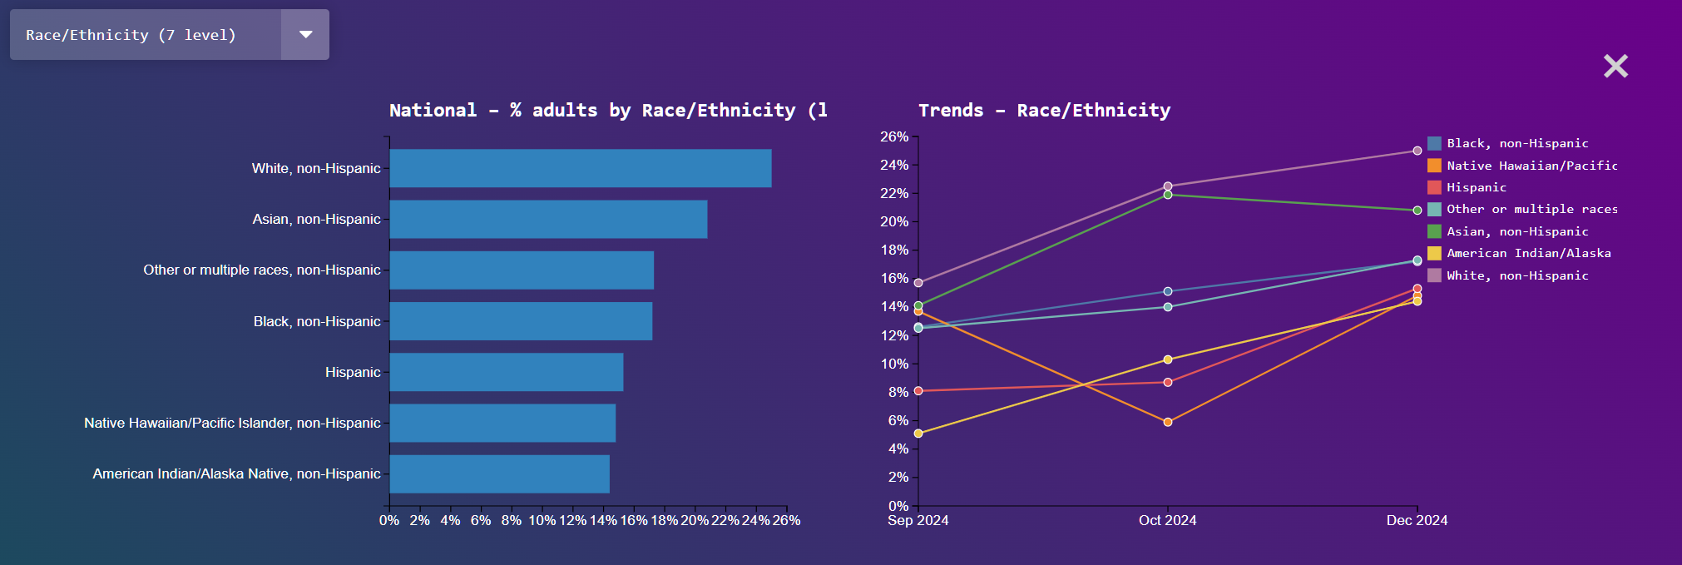
PROCESS - IMPLEMENTATION PHASE 5
NATIONAL VIEW:
Observing detailed statistics from the national view will open the same view for national statistics instead of state, offering the same interactivity and options.

Slide 19
PROCESS - TECH STRUGGLES
Apart from our initial struggles with D3 and acclimating to a new web-app infrastructure, we had, and also are currently having issues with integrating the several different approaches into one cohesive experience.
There are several examples of integration issues:
Making sure that the national view works while supporting state levels data, which is being added
recurring challenge, and something we want to find workarounds for
Verifying, cleaning, and JSON-ifying data
Adding overlay for detailed views, and making sure it works along with national (and now state) view

Slide 20
PROCESS - TECH STRUGGLES (CONT)
Another technical struggle we are facing is utilizing git for version-control. With 3 of us working on the project simultaneously and our git-experience varying, sometimes commits or branch merges can go wrong and other’s code could suddenly break due to oversights by other team members.
We are doing our best as a team to have others review our changes via git approvals before making large changes to the project official. We believe that keeping and staying up to date with advanced VCS principles, such as merges, rebases, PR/MR structure is important, and we are driven to improve our skillset.

Slide 21
PROCESS - OTHER STRUGGLES
While our team has had great communication thus far, we have realized that it has been difficult to find times to meet as the 3 of us have varying schedules and responsibilities. This has made it difficult to have face-to-face meetings where we can work together on developing our project and sharing ideas, so we have had to resort to frequent updates in our team chat.
While this is not ideal, we are doing our best to make time for future team meetings and keep each other consistently updated even when we don’t have the proper time to meet face to face.

Slide 22
PROCESS - OTHER STRUGGLES
Lastly, we were all quite busy with finals, and it was hard to continue working on the project with the same cadence. Our solution to this was to split up the work into bigger tasks, so that one person did not need to rely on another person in order to do a smaller task. We continued to review each other’s code via Pull Requests, which saved us a lot of time fixing bugs could have that happened once merged.

Slide 23
Evaluation
We can start by answering the questions:
How do the vaccination rates change across the country?
In general, states with a higher population (California/Texas/Florida, etc.) have a higher vaccination rate. It seems more states in the northwest are less vaccinated than their northeast counterparts.
What might be an indicator of vaccination rates for covid vs flu? Why might one be higher than the other?
The flu rates are significantly higher, and this is probably due to the time frame that the flu has been around, which is much longer than Covid. This is especially true in the case of individuals aged 60+.
What effect do the different metrics have on vaccination rates for both Covid and Flu?
It seems as though for Covid, rates across sexual orientation groups are similar, however, for Flu, heterosexual individuals were more vaccinated. Similar occurs for metropolitan statistical area, where suburban groups were vaccinated relatively less for covid than flu. For poverty status, race/ethnicity, sex, they remained similar in both settings. In general, more individuals aged 18-49 had the flu vaccine.
How do vaccination rates for Covid change throughout the pandemic?
As the years go on, the rates increase. However, the rate of increase for more populous states is higher than lower population states.

Slide 24
Evaluation - Visualization
It is important to analyze our visualization in the context of accessibility. Thus, we answer the following questions.
What are the main channels and marks we used to encode information? Did they follow the effectiveness principle? What about the expressiveness principle?
The main marks and channels are position(location of state), size(of state), color(which vaccination). The marks are the points (vaccination sites) lines (county borders) and areas(size). We believe this follows the effectiveness principle since position and size are used for quantitative data and color is used where position is less effective. Similarly, it is expressive since color is used for categorical data and size is used for quantitative data.
Is sufficient context provided?
Yes, since there is context provided at the bottom of the page, and that remains throughout the interactions.
Is color used appropriately?
Yes. The color choices were intentionally made in order to accommodate individuals with visual impairments, and in order to communicate whether it was Covid or Flu data.

Slide 25
Evaluation - Limitations
Some limitations/further improvements of the visualization are listed below:
Vaccination Rates by county could be added, if appropriate data is available.
The state graphs could be side by side instead of an overlay. This may be difficult on different device types.
There can be more user formatting, whether that be toggles on top of the state graph statistics instead of drop downs, or an addition to view 2 graphs on different metrics side by side.
We should be able to implement a side by side functionality of viewing the covid and flu data for a section side by side (i.e. seeing California’s vaccination sites for covid and flu side by side. This can help answer the questions of comparison much better.

Slide 26
Citations
Samore, Theodore, et al. “Of Pathogens and Party Lines: Social Conservatism Positively Associates with COVID-19 Precautions among U.S. Democrats but Not Republicans.” PLOS ONE, vol. 16, no. 6, 29 June 2021, p. e0253326, https://doi.org/10.1371/journal.pone.0253326.
“The Lancet: Largest US State-By-State Analysis of COVID-19 Impact Reveals the Driving Forces behind Variations in Health, Education, and Economic Performance.” Institute for Health Metrics and Evaluation, www.healthdata.org/news-events/newsroom/news-releases/lancet-largest-us-state-state-analysis-covid-19-impact-reveals.
“About the National Immunization Surveys (NIS).” Centers for Disease Control and Prevention, Centers for Disease Control and Prevention, www.cdc.gov/nis/about/index.html. Accessed 8 May 2025.

Slide 27
Citations (Code)
“How to set up Github Pages to deploy repositories from different source folders without Actions” prompt. ChatGPT, May 8th, 2025, OpenAI
“Altering text elements in mouseover event in d3” prompt. ChatGPT, April 15th, 2025
“Linear Scale examples with domain and range” prompt. ChatGPT, April 20th, 2025, OpenAI
“How do I map city data to longitude/latitude, if I have the data in Json Format?” prompt. ChatGPT, April 3rd, 2025, OpenAI
“What is the process to use d3.js for hover?” prompt. ChatGPT, April 18th, 2025, OpenAI
“Briefly summarize how to use css style to make different shades of a color across an array. ” prompt. ChatGPT, March 22nd, 2025, OpenAI

